Slide 1
Example
SQL Question :
Schema:
Product(maker, model, type)
PC(model, speed, ram, hd, price)
Laptop(model, speed, ram, hd, screen, price)
Printer(model, color, type, price)
Write SQL to find Maker, Model, Screen Size, and Price for laptops with screens larger than 15 inches.

Slide 2
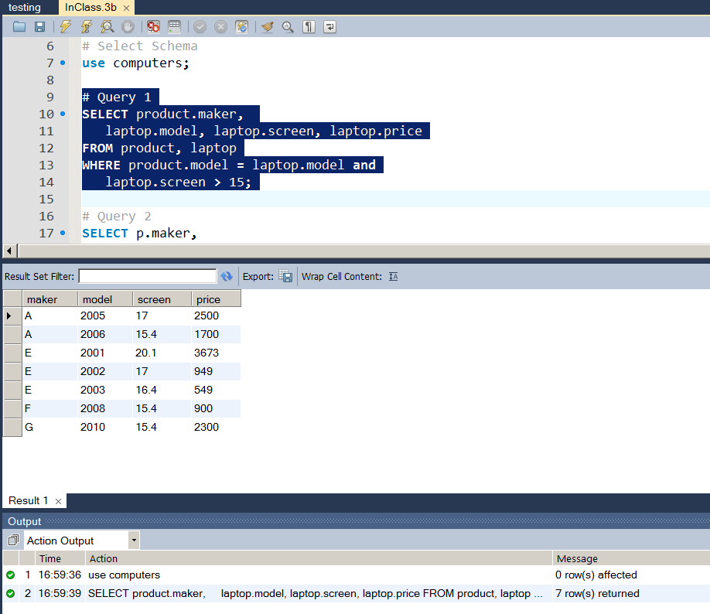
In-Class 3b – Query 1
Schema:
Product(maker, model, type)
PC(model, speed, ram, hd, price)
Laptop(model, speed, ram, hd, screen, price)
Printer(model, color, type, price)
Write SQL to find Maker, Model, Screen Size, and Price for laptops with screens larger than 15 inches.
SELECT product.maker,
laptop.model, laptop.screen, laptop.price
FROM product, laptop
WHERE product.model = laptop.model and
laptop.screen > 15;

Slide 3
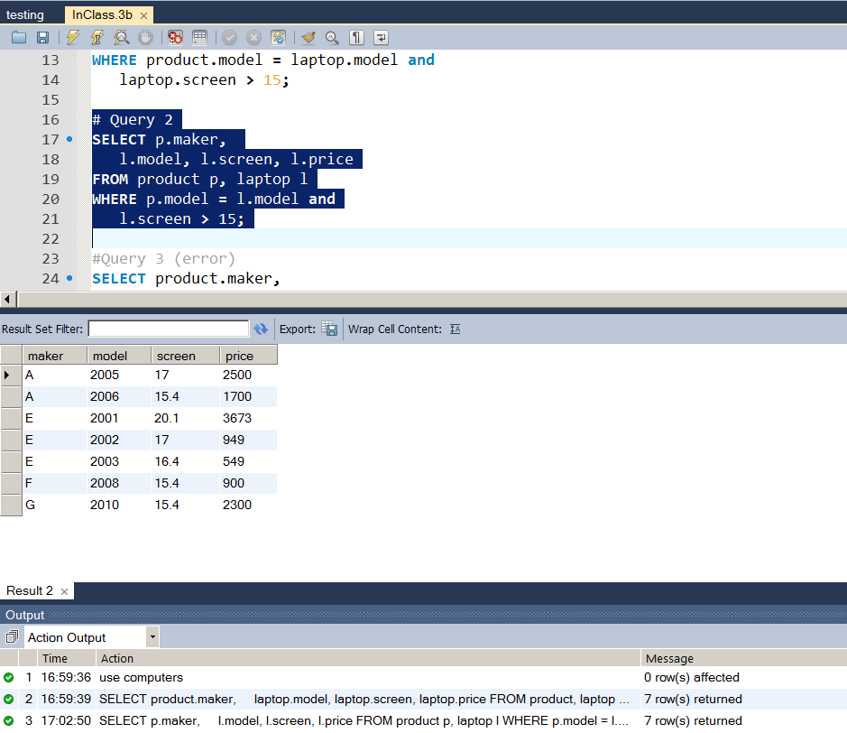
In-Class 3b – Query 2
Schema:
Product(maker, model, type)
PC(model, speed, ram, hd, price)
Laptop(model, speed, ram, hd, screen, price)
Printer(model, color, type, price)
Write SQL to find Maker, Model, Screen Size, and Price for laptops with screens larger than 15 inches.
SELECT p.maker,
l.model, l.screen, l.price
FROM product p, laptop l
WHERE p.model = l.model and
l.screen > 15;

Slide 4
Example
Schema:
Product(maker, model, type)
PC(model, speed, ram, hd, price)
Laptop(model, speed, ram, hd, screen, price)
Printer(model, color, type, price) ¼
Write SQL to find Maker, Model, Screen Size, and Price for laptops with screens larger than 15 inches.
SELECT p.maker,
l.model, l.screen, l.price
FROM product p, laptop l
WHERE p.model = l.model and
l.screen >= 15;

Slide 5
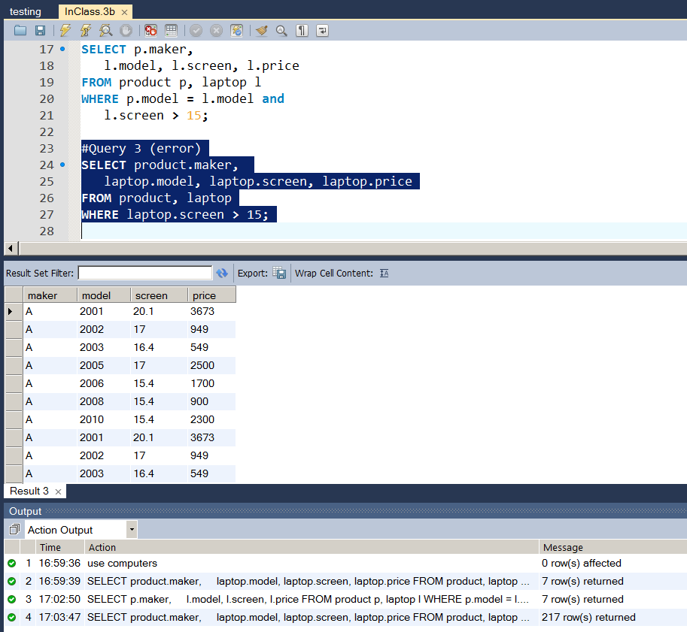
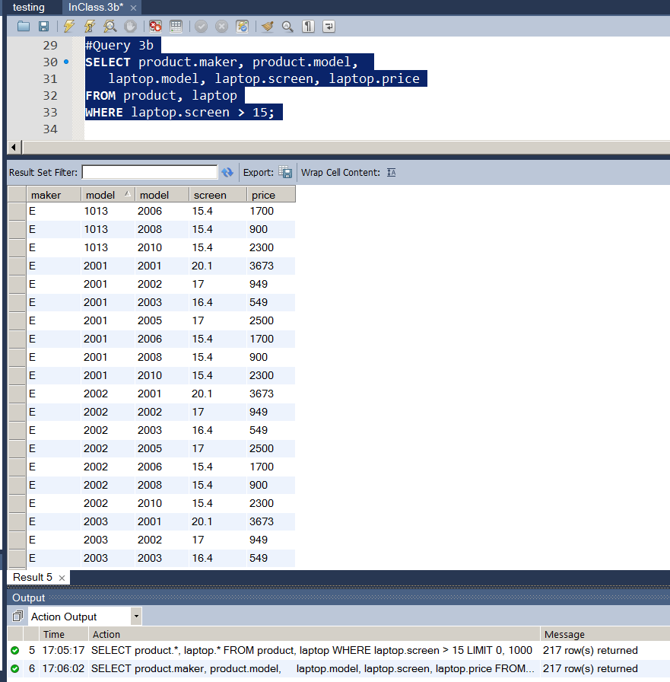
In-Class 3b – Error 2 (-1 point) 6 Cases
Schema:
Product(maker, model, type)
PC(model, speed, ram, hd, price)
Laptop(model, speed, ram, hd, screen, price)
Printer(model, color, type, price) ¼
Write SQL to find Maker, Model, Screen Size, and Price for laptops with screens larger than 15 inches.
SELECT product.maker,
laptop.model, laptop.screen, laptop.price
FROM product, laptop
WHERE laptop.screen > 15;

Slide 6
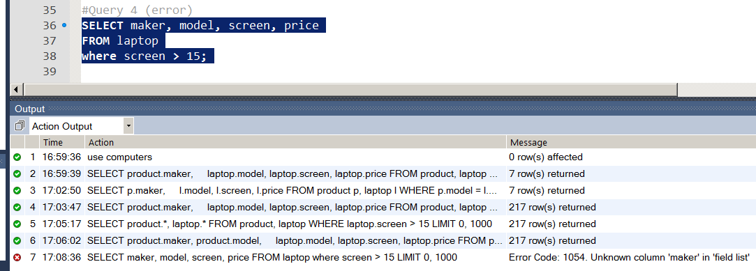
Example
Schema:
Product(maker, model, type)
PC(model, speed, ram, hd, price)
Laptop(model, speed, ram, hd, screen, price)
Printer(model, color, type, price) ¼
Write SQL to find Maker, Model, Screen Size, and Price for laptops with screens larger than 15 inches.
SELECT maker, model, screen, price
FROM laptop
WHERE screen > 15;

Slide 7
SQL 2 Chapter 6
Set Operations
Subqueries
In, Not In
Exists, Not Exists
Any, All
Examples

Slide 8
Select-From-Where Statements
Always remember, and never forget:
SELECT * FROM table ;
SELECT attribute FROM table
WHERE attribute = value ;

Slide 9
Select-From-Where Statements
Always remember, and never forget:
SELECT * FROM table ;
SELECT attribute FROM table
WHERE attribute = value ;
SELECT desired attributes
FROM one or more tables
WHERE condition about tuples of
the tables

Slide 10
Set Operations
UNION
UNION ALL
INTERSECT
not in MySQL
Later using subqueries
SUBTRACT/EXCEPT
Not In MySQL
Later using subqueries

Slide 11
Operators Union
X ∪ Y
K | D | E
1 | 1 | 8
2 | 1 | 7
K | D | E
4 | 1 | 6
5 | 1 | 5
K | D | E
4 | 1 | 6
5 | 1 | 5
1 | 1 | 8
2 | 1 | 7
X
Y
X ∪ Y

Slide 12
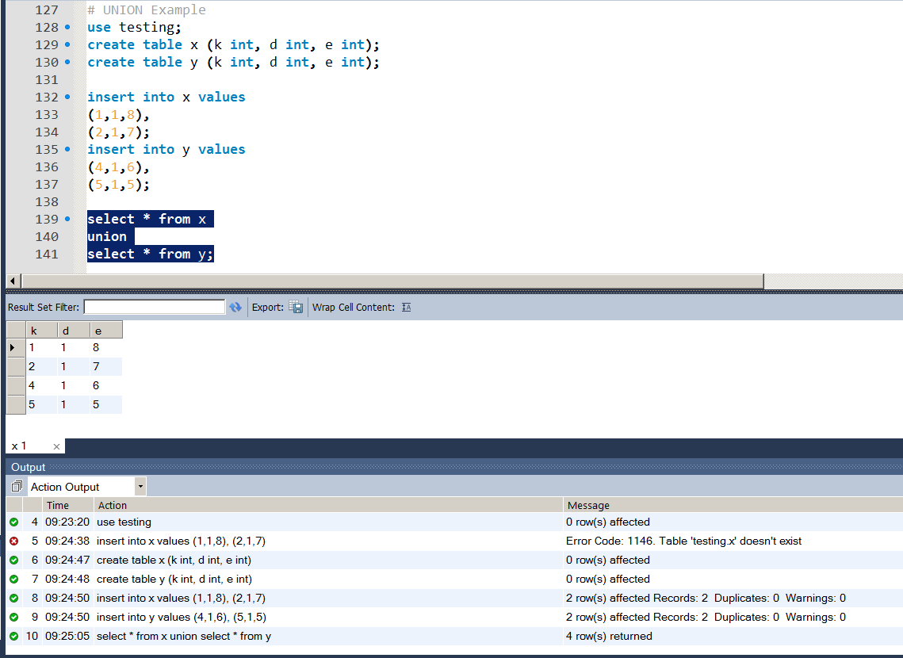
Operators: Union
X ∪ Y
SQL:
SELECT * FROM X
UNION
SELECT * FROM Y:
K | D | E
1 | 1 | 8
2 | 1 | 7
K | D | E
4 | 1 | 6
5 | 1 | 5
K | D | E
4 | 1 | 6
5 | 1 | 5
1 | 1 | 8
2 | 1 | 7
X
Y
X ∪ Y

Slide 13
Operators: Union
X ∪ Y
SQL:
SELECT * FROM X
UNION
SELECT * FROM Y:
K | D | E
1 | 1 | 8
2 | 1 | 7
K | D | E
4 | 1 | 6
5 | 1 | 5
2 | 1 | 7
K | D | E
4 | 1 | 6
5 | 1 | 5
1 | 1 | 8
2 | 1 | 7
X
Y
X ∪ Y

Slide 14
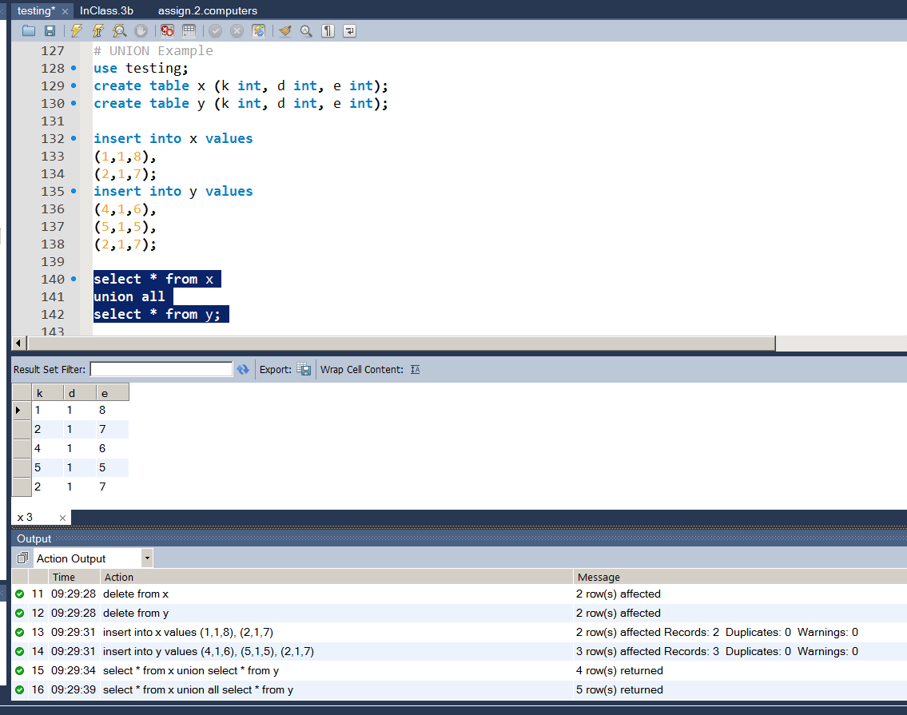
Operators: Union
X ∪ Y
SQL:
SELECT * FROM X
UNION ALL
SELECT * FROM Y:
K | D | E
1 | 1 | 8
2 | 1 | 7
K | D | E
4 | 1 | 6
5 | 1 | 5
2 | 1 | 7
K | D | E
4 | 1 | 6
5 | 1 | 5
1 | 1 | 8
2 | 1 | 7
2 | 1 | 7
X
Y
UNION ALL

Slide 15
c) Find all model number and price of all products (of any type) made by manufacturer B
R1 := σ_{maker=B} (Product ⋈ PC)
R2 := σ_{maker=B} (Product ⋈ Laptop)
R3 := σ_{maker=B} (Product ⋈ Printer)
R4 := π_{model,price} (R1)
R5 := π_{model,price} (R2)
R6: = π_{model,price} (R3)
R7 := R4 ∪ R5 ∪ R6
model | price
1004 | 649
1005 | 630
1006 | 1049
2007 | 1429

Slide 16
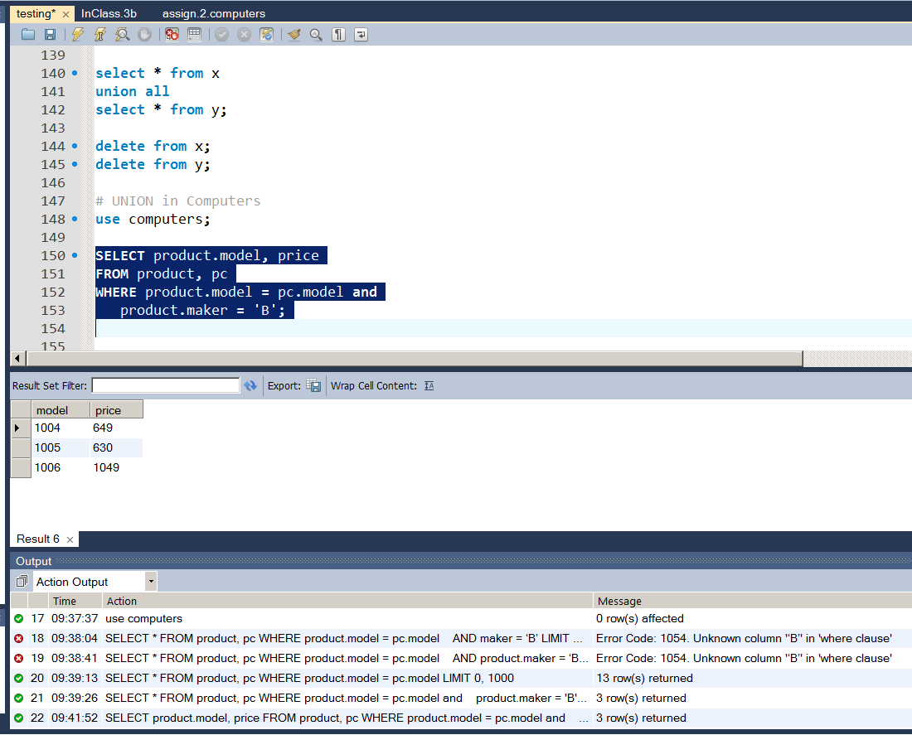
c) Find all model number and price of all products (of any type) made by manufacturer B
R1 := σ_{maker=B} (Product ⋈ PC)
R4 := π_{model,price} (R1)
SQL:
SELECT product.model, price
FROM product, pc
WHERE product.model = pc.model
AND maker = ‘B’;

Slide 17
c) Find all model number and price of all products (of any type) made by manufacturer B
R1 := σ_{maker=B} (Product ⋈ PC)
R4 := π_{model,price} (R1)
R2 := σ_{maker=B} (Product ⋈ Laptop)
R5 := π_{model,price} (R2)
R3 := σ_{maker=B} (Product ⋈ Printer)
R6: = π_{model,price} (R3)

Slide 18
c) Find all model number and price of all products (of any type) made by manufacturer B
SELECT product.model, price
FROM product, pc
WHERE product.model = pc.model
AND maker = ‘B’;
SELECT product.model, price
FROM product, laptop
WHERE product.model = laptop.model
AND maker = ‘B’;
SELECT product.model, price
FROM product, printer
WHERE product.model = printer.model
AND maker = ‘B’;

Slide 19
c) Find all model number and price of all products (of any type) made by manufacturer B
R1 := σ_{maker=B} (Product ⋈ PC)
R2 := σ_{maker=B} (Product ⋈ Laptop)
R3 := σ_{maker=B} (Product ⋈ Printer)
R4 := π_{model,price} (R1)
R5 := π_{model,price} (R2)
R6: = π_{model,price} (R3)
R7 := R4 ∪ R5 ∪ R6
model | price
1004 | 649
1005 | 630
1006 | 1049
2007 | 1429

Slide 20
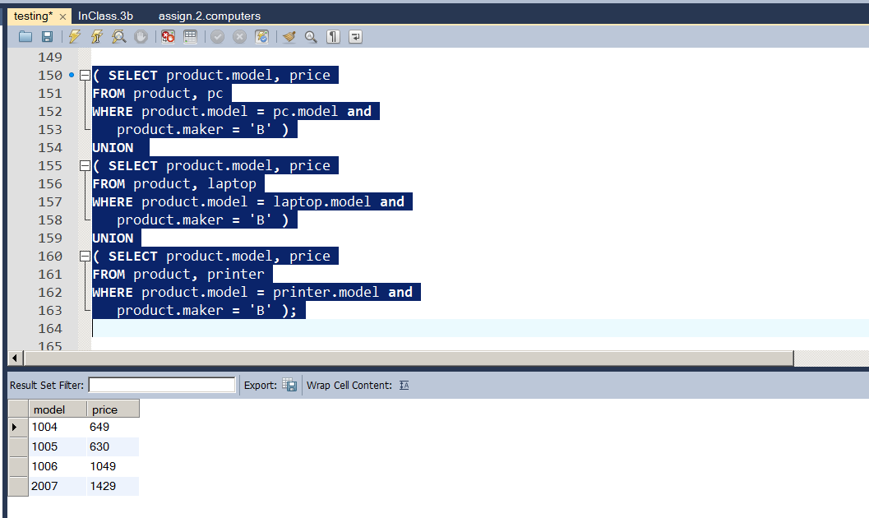
c) Find all model number and price of all products (of any type) made by manufacturer B
( SELECT product.model, price
FROM product, pc
WHERE product.model = pc.model
AND maker = ‘B’ )
UNION
( SELECT product.model, price
FROM product, laptop
WHERE product.model = laptop.model
AND maker = ‘B’ )
UNION
( SELECT product.model, price
FROM product, printer
WHERE product.model = printer.model
AND maker = ‘B’ ) ;

Slide 21
Subqueries
SUBquery is Query used inside another Query
Subquery is a parenthesized SELECT-FROM-WHERE statement
Subquery places like WHERE, FROM & SELECT clause.
Just saw a Subquery in our Union Example

Slide 22
c) Find all model number and price of all products (of any type) made by manufacturer B
( SELECT product.model, price
FROM product, pc
WHERE product.model = pc.model
AND maker = ‘B’ )
UNION
( SELECT product.model, price
FROM product, laptop
WHERE product.model = laptop.model
AND maker = ‘B’ )
UNION
( SELECT product.model, price
FROM product, printer
WHERE product.model = printer.model
AND maker = ‘B’ ) ;

Slide 23
Songs Domain
Queries : List all songs by three different artists.
select artist, track from songs
where upper(artist) like upper('%eagles%' ) union
select artist, track from songs
where upper(artist) like upper('%Allman%' ) union select artist, track from songs
where upper(artist) like upper('%Clearwater%' );

Slide 24
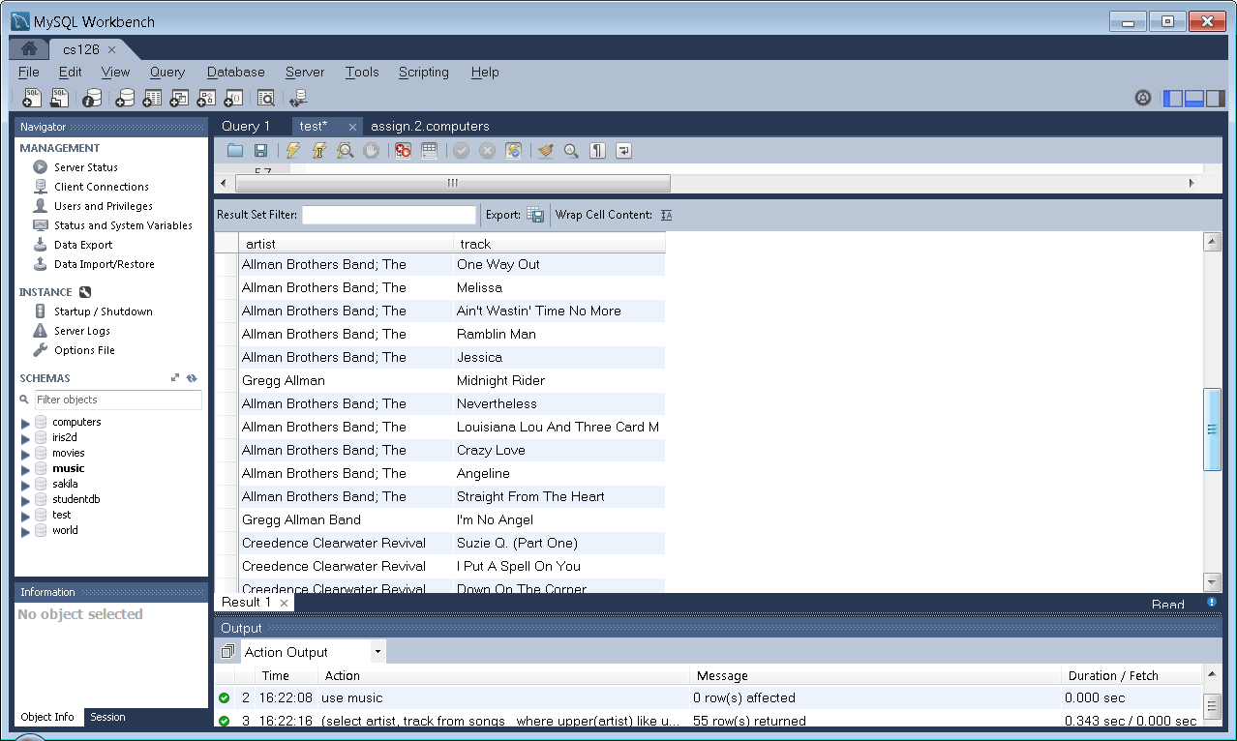
Songs Domain
Queries : List all songs by three different artists.
(select artist, track from songs
where upper(artist) like upper('%eagles%' ) )
UNION
(select artist, track from songs
where upper(artist) like upper('%Allman%' ) )
UNION
(select artist, track from songs
where upper(artist) like upper('%Clearwater%' ) );

Slide 25
Subqueries IN FROM Clause
In FROM Clause, Parenthesized Query operates like Relation.
Parenthesized Query must be named with a tuple variable.

Slide 26
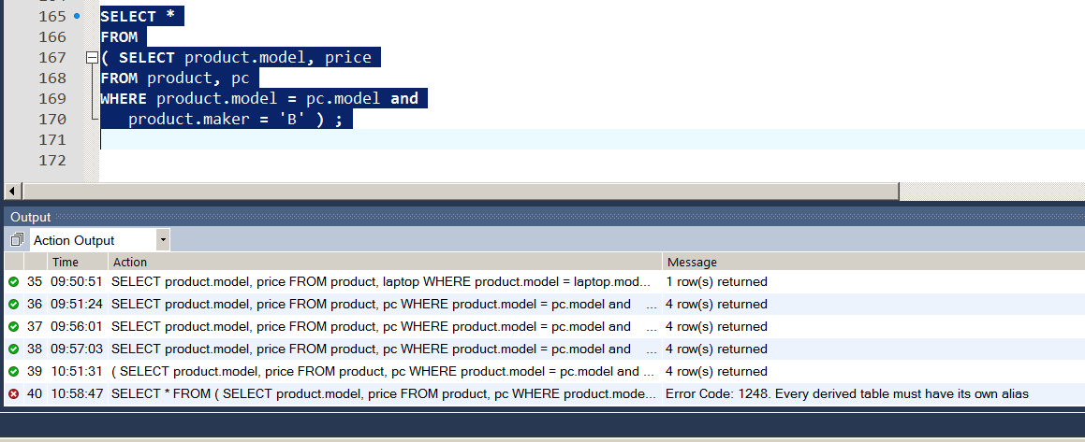
Subqueries IN FROM Clause
EXAMPLE
SELECT *
FROM
( SELECT product.model, price
FROM product, pc
WHERE product.model = pc.model and
product.maker = 'B' ) ;

Slide 27
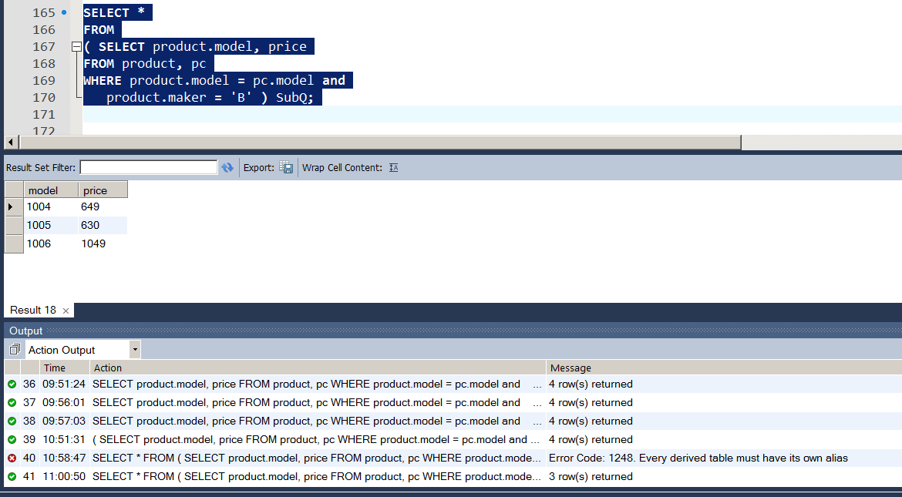
Subqueries IN FROM Clause
EXAMPLE: Needs Tuple Variabe (i.e., SubQ)
SELECT *
FROM
( SELECT product.model, price
FROM product, pc
WHERE product.model = pc.model and
product.maker = 'B' ) SubQ ;

Slide 28
SubQueries IN WHERE Clause
Conditions Involving Relations
Example:
Set Membership:
a IN (Relation R1)
NOT a IN (Relation R1)
a NOT IN (Relation R1)

Slide 29
The IN Operator
<tuple> IN (<subquery>)
TRUE: <tuple> is a member of <subquery> relation.
Opposite Value: NOT IN
Used in WHERE clause

Slide 30
Subqueries Exercise – 2.4.1
Product(maker, model, type)
PC(model, speed, ram, hd, price)
Laptop(model, speed, ram, hd, screen, price)
Printer(model, color, type, price)
Find those manufacturers that sell PC’s and inexpensive laptops(laptops less than 1000.00).

Slide 31
Subqueries
Let’s find the Makers PC’s and inexpensive laptops
Price < 1000
Step 1: Find the makers of inexpensive laptops
SELECT maker
FROM product, laptop
WHERE price < 1000;
Step 2: Subquery

Slide 32
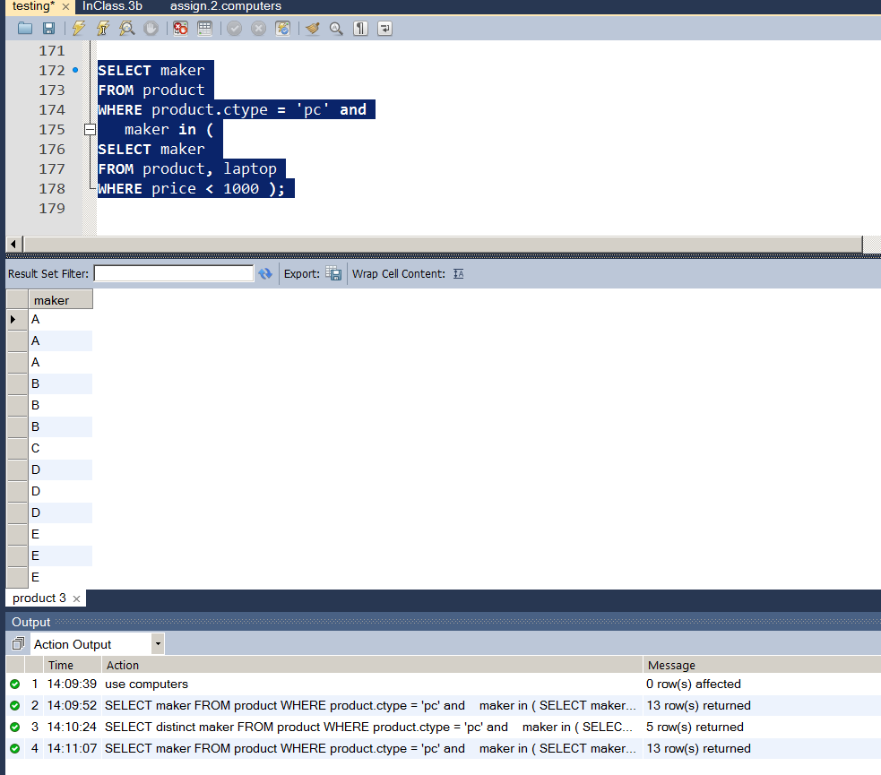
Subqueries w/ IN
Let’s find the Makers PC’s and inexpensive laptops
Price < 1000
Step 2: Use Subquery
SELECT maker
FROM product
WHERE product.ctype = ‘pc’ and
maker in (
SELECT maker
FROM product, laptop
WHERE price < 1000 );

Slide 33
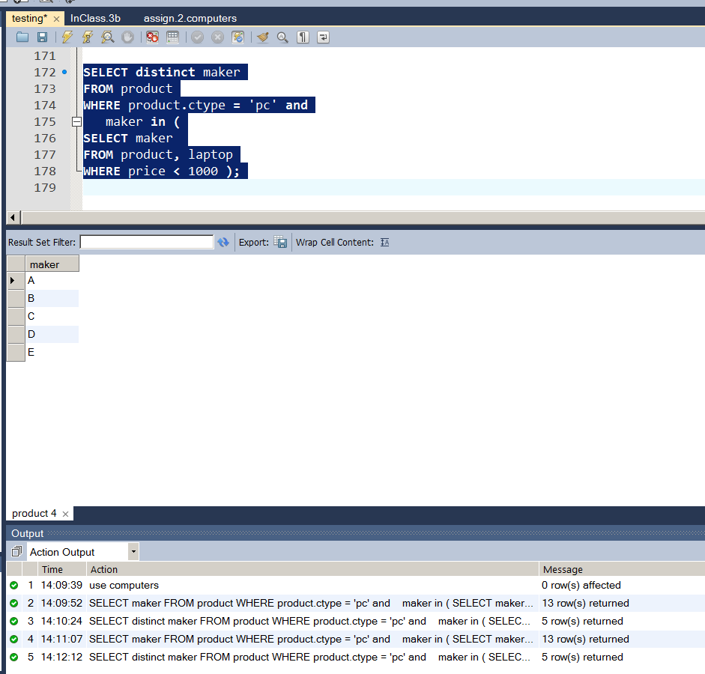
Subqueries w/ IN
Let’s find the Makers PC’s and inexpensive laptops
Price < 1000
Step 2: Use Subquery
SELECT distinct maker
FROM product
WHERE product.ctype = ‘pc’ and
maker in (
SELECT maker
FROM product, laptop
WHERE price < 1000 );

Slide 34
DISTINCT w/ SELECT
DISTINCT keyword:
Removes redundant tuples from returned relation.

Slide 35
Example: Exercise – 2.4.1
Product(maker, model, type)
PC(model, speed, ram, hd, price)
Laptop(model, speed, ram, hd, screen, price)
Printer(model, color, type, price)
d) Find those manufacturers that sell laptops, but not PC’s.

Slide 36
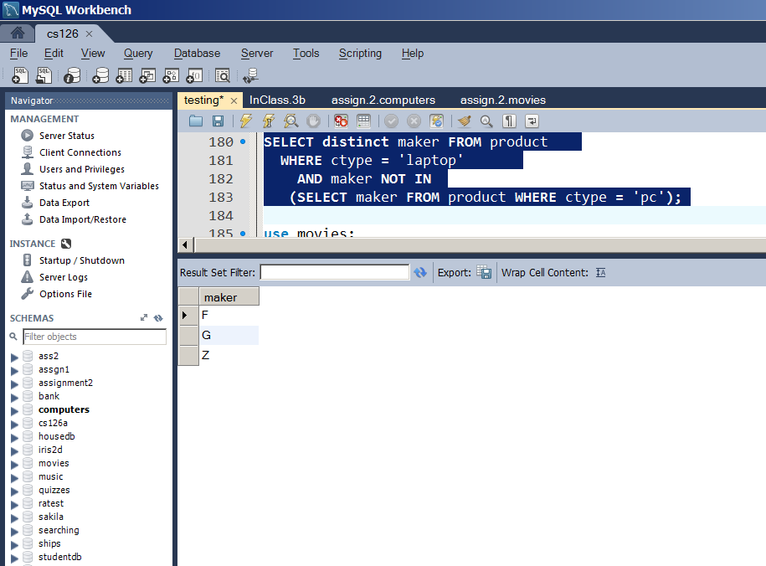
Example: Exercise – 2.4.1
Product(maker, model, type),
PC(model, speed, ram, hd, price)
Laptop(model, speed, ram, hd, screen, price)
Printer(model, color, type, price)
d) Find those manufacturers that sell laptops, but not PC’s.
SELECT distinct maker FROM product
WHERE ctype = 'laptop'
AND maker NOT IN
(SELECT maker FROM product WHERE ctype = 'pc');

Slide 37
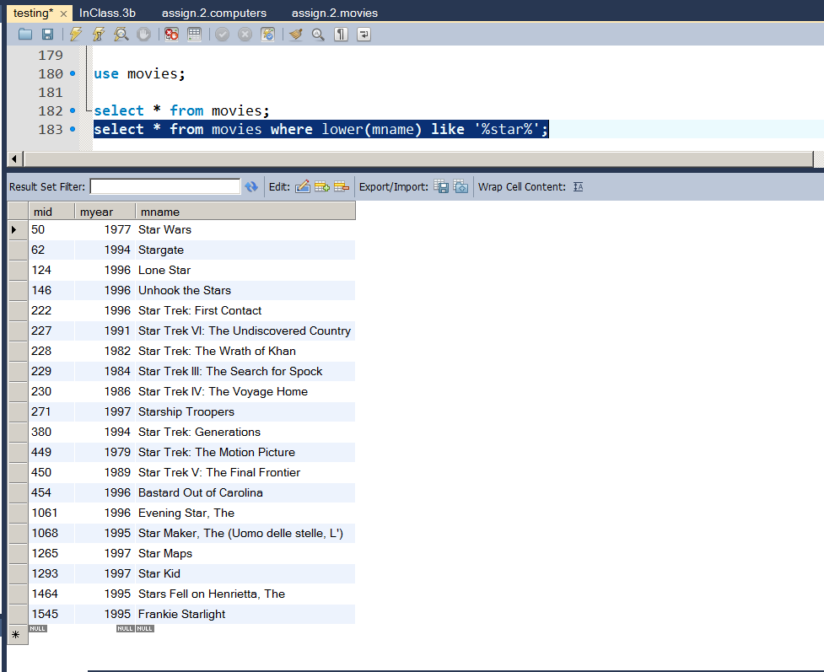
Movie Ratings Domain
Take a look at movies with ‘star’ in the name
SELECT *
FROM movies
WHERE lower(mname) like ‘%star%’;

Slide 38
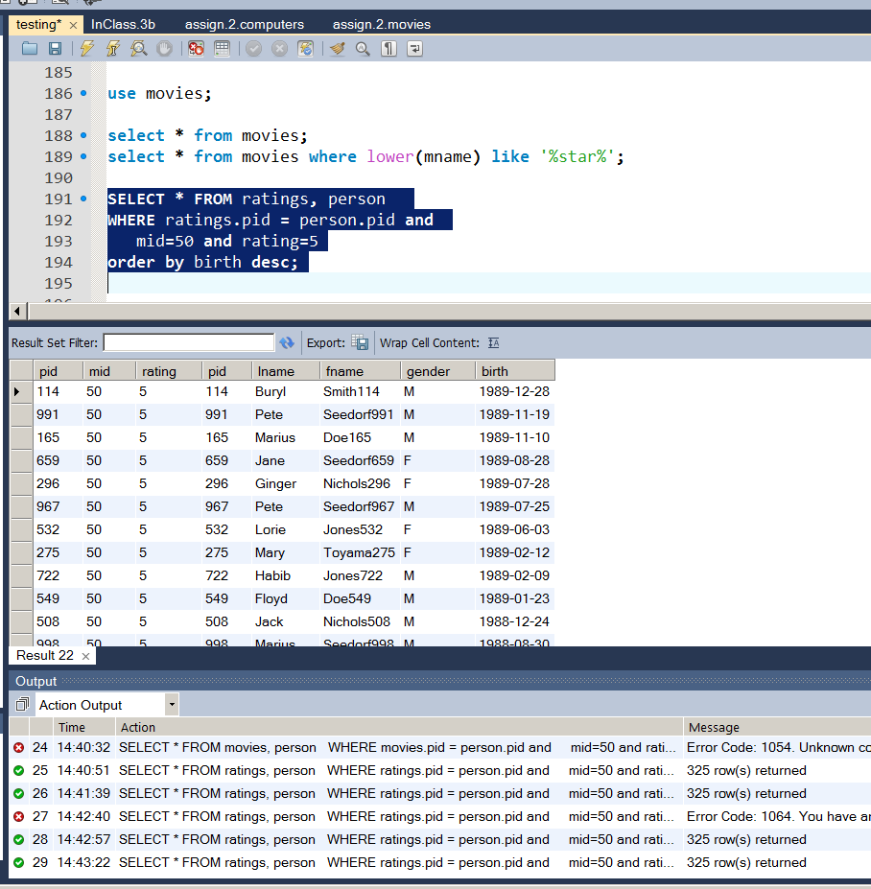
Movie Ratings Domain
Star Wars has id 50
Who rated Star Wars a 5
ratings(pid int, mid int, rating int, key (pid, mid))
Person(pid int primary key,
lName varchar(20), fName varchar(20), gender char(1), birth date)
SELECT * FROM ratings, person
WHERE ratings.pid = person.pid AND
mid=50 AND rating=5
ORDER BY birth DESC;

Slide 39
Movie Ratings Domain
Who rated Star Wars and Star Trek: First Contact a 5
ratings(pid int, mid int, rating int, key (pid, mid))
Person(pid int primary key,
lName varchar(20), fName varchar(20), gender char(1), birth date)

Slide 40
Movie Ratings Domain
Take a look at movies with ‘star’ in the name
SELECT *
FROM movies
WHERE lower(mname) like ‘%star%’;

Slide 41
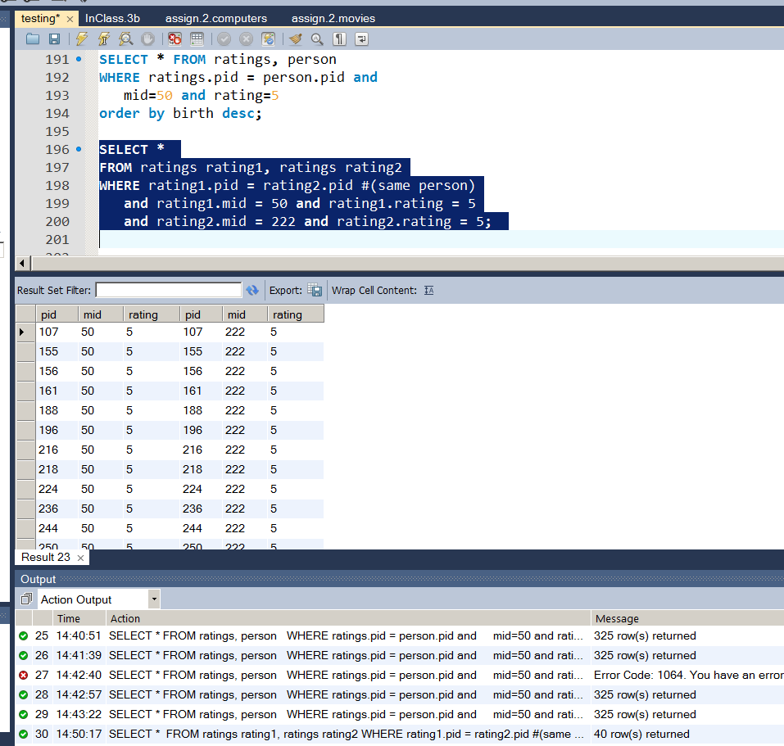
Movie Ratings Domain
Who rated Star Wars and Star Trek: First Contact a 5
Star Wars has id = 5
Star Trek: First Contact has id = 222
ratings(pid int, mid int, rating int, key (pid, mid))
Person(pid int primary key,
lName varchar(20), fName varchar(20), gender char(1), birth date)
SELECT *
FROM ratings rating1, ratings rating2
WHERE rating1.pid = rating2.pid #(same person)
and rating1.mid = 50 and rating1.rating = 5
and rating2.mid = 222 and rating2.rating = 5;

Slide 42
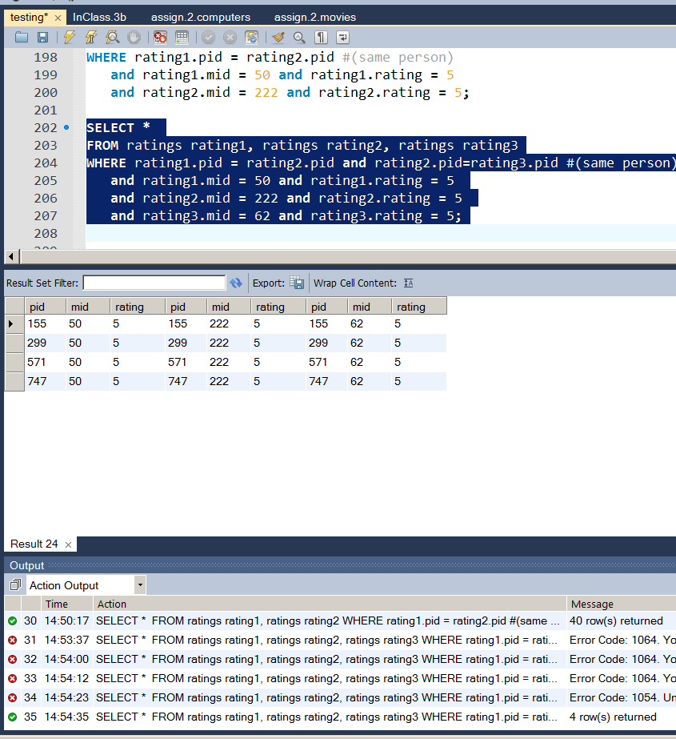
Movie Ratings Domain
Who rated Star Wars and Star Trek: First Contact and Stargate a 5
Star Wars has id = 5
Star Trek: First Contact has id = 222
Stargate has id = 62
ratings(pid int, mid int, rating int, key (pid, mid))
Person(pid int primary key,
lName varchar(20), fName varchar(20), gender char(1), birth date)
SELECT *
FROM ratings rating1, ratings rating2, ratings rating3
WHERE rating1.pid = rating2.pid and rating2.pid = rating3.pid #(same person)
and rating1.mid = 50 and rating1.rating = 5
and rating2.mid = 222 and rating2.rating = 5
and rating3.mid = 62 and rating3.rating=5;

Slide 43
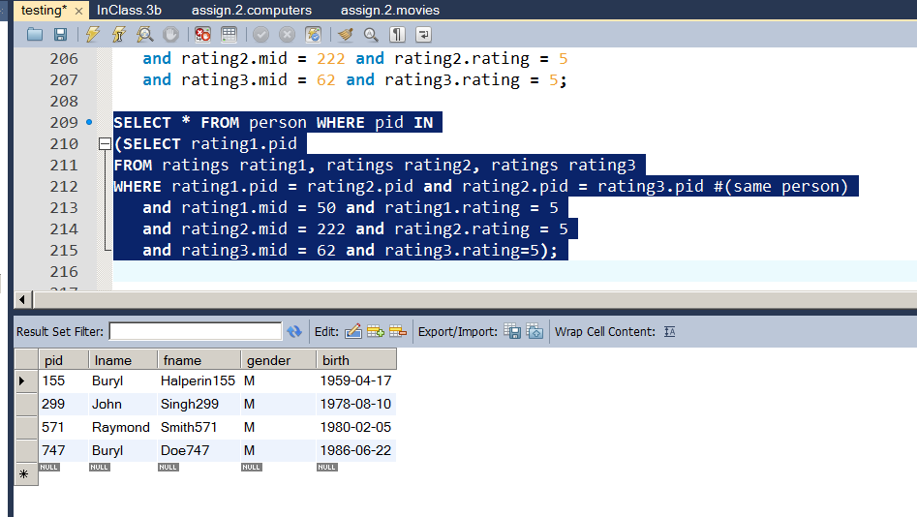
Movie Ratings Domain
Who rated Star Wars and Star Trek: First Contact and Stargate a 5
Star Wars has id = 5
Star Trek: First Contact has id = 222
Stargate has id = 62
ratings(pid int, mid int, rating int, key (pid, mid))
Person(pid int primary key,
lName varchar(20), fName varchar(20), gender char(1), birth date)
SELECT * FROM person WHERE pid IN
(SELECT rating1.pid
FROM ratings rating1, ratings rating2, ratings rating3
WHERE rating1.pid = rating2.pid and rating2.pid = rating3.pid #(same person)
and rating1.mid = 50 and rating1.rating = 5
and rating2.mid = 222 and rating2.rating = 5
and rating3.mid = 62 and rating3.rating=5);

Slide 44
Other Questions
When did these customers rate these movies?
Any pattrern to timing
Any other correlations between the ratings of this group?

Slide 45
Movie Ratings Domain
Queries : Look at ratings for a group of movies.
Checking the ratings for the right list of movies can say much!
Automatically finding info like the discriminating movie list is goal.
select a.pid, a.rating, b.rating, c.rating, d.rating, e.rating
from movie_ratings a, movie_ratings b,
movie_ratings c, movie_ratings d, movie_ratings e
where a.pid=b.pid and b.pid =c.pid and c.pid = d.pid
and d.pid = e.pid and a.mid = 99 and b.mid = 313
and c.mid = 420 and d.mid = 465 and e.mid = 588

Slide 46
Movie Ratings Domain
pid | rating | rating | rating | rating | rating
137 | 5 | 5 | 5 | 5 | 5
148 | 4 | 3 | 4 | 3 | 4
184 | 5 | 4 | 4 | 4 | 3
193 | 3 | 4 | 4 | 5 | 4
229 | 5 | 5 | 5 | 5 | 4
299 | 5 | 5 | 5 | 4 | 5
379 | 2 | 3 | 3 | 3 | 5
477 | 4 | 5 | 4 | 3 | 5
492 | 3 | 4 | 3 | 4 | 4
504 | 5 | 4 | 5 | 1 | 2
571 | 3 | 5 | 3 | 3 | 3
719 | 3 | 5 | 3 | 4 | 5
741 | 2 | 5 | 4 | 4 | 5
906 | 5 | 5 | 3 | 4 | 5
1010 | 3 | 2 | 4 | 5 | 4

Slide 47
Movie Ratings Domain
pid | 99 | 313 | 420 | 465 | 588
137 | 5 | 5 | 5 | 5 | 5
229 | 5 | 5 | 5 | 5 | 4
299 | 5 | 5 | 5 | 4 | 5
906 | 5 | 5 | 3 | 4 | 5
504 | 5 | 4 | 5 | 1 | 2
184 | 5 | 4 | 4 | 4 | 3
477 | 4 | 5 | 4 | 3 | 5
148 | 4 | 3 | 4 | 3 | 4
719 | 3 | 5 | 3 | 4 | 5
571 | 3 | 5 | 3 | 3 | 3
193 | 3 | 4 | 4 | 5 | 4
492 | 3 | 4 | 3 | 4 | 4
1010 | 3 | 2 | 4 | 5 | 4
741 | 2 | 5 | 4 | 4 | 5
379 | 2 | 3 | 3 | 3 | 5

Slide 48
Movie Ratings Domain
Queries : What was average movie rating for a set of movies?
select (select mname from movie_list where mid=99) AS 'Movie',
count(*) as 'number of reviews',
avg(rating) as 'avg rating'
from movie_ratings where mid=99
UNION
select (select mname from movie_list where mid=313) AS 'Movie',
count(*) as 'number of reviews',
avg(rating) as 'avg rating' from movie_ratings where mid=313;

Slide 49
Movie Ratings Domain More Next Time
Queries : What was average movie rating for a set of movies?
Movie | number of reviews | avg rating
Titanic | 350 | 4.2457
Beauty and the Beast | 202 | 3.7921
Snow White and the Seven Dwarfs | 172 | 3.7093
Alice in Wonderland | 81 | 3.6667
Jungle Book, The | 85 | 3.5647

Slide 50
Movie Ratings Domain
Queries : How many records in DB where two people equally rated the same movie.
select count(*)
from movie_ratings a, movie_ratings b
where a.mid = b.mid and
a.rating = b.rating and
a.pid < b.pid;

Slide 51
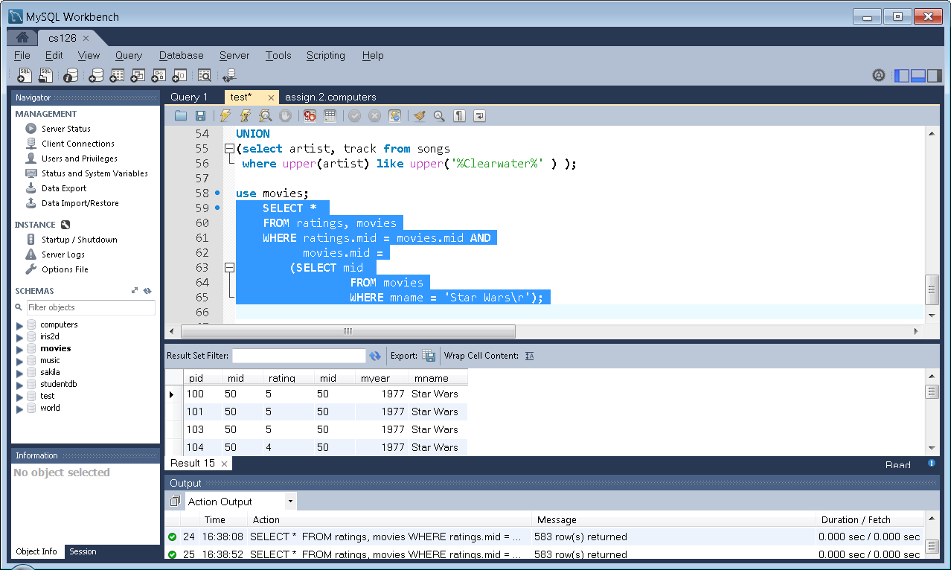
Subquery return Scalar
SELECT *
FROM ratings, movies
WHERE ratings.mid = movies.mid AND
movies.mid =
(SELECT mid
FROM movies
WHERE mname = ‘Star Wars\r’);

Slide 52
The Any Operator
x = ANY(<subquery>)
True: x equals at least one tuple in the subquery relation.
x >= ANY(<subquery>)
True: x is not the uniquely smallest value produced by the subquery.

Slide 53
The Any Operator
create table c1 (x char(1), y char(1));
create table c2 (z char(1));
insert into c1 values ('A', 'a'), ('B','b'), ('C','c'),
('D', 'd'), ('E','e'),('F','f'),('G','g'),('H','h');
insert into c2 value ('B'),('D')

Slide 54
The Any Operator
create table c1 (x char(1), y char(1));
create table c2 (z char(1));
select x from c1;
(A, B, C, D, E, F, G, H)
select x from c1 where x > any (select x from c1);
(B, C, D, E, F, G, H)

Slide 55
The All Operator
x <> ALL(<subquery>)
True: x does not equal any tuple in subquery.
x >= ALL(<subquery>)
True: no tuple larger than x in the subquery result.

Slide 56
The All Operator
Select z from c2;
(B, D)
select x from c1 where
x > all (select z from c2);
(E, F, G, H)

Slide 57
The All Operator: Computer Schema
Select maker from manf;
(A, B, C, D, E, F, G, H)
select distinct(maker) from product where ctype = 'pc';
(A, B, C, D, E)
select maker from manf where maker <> all (select maker from product where ctype = 'pc');
(F, G, H)
Equivalent to Not In

Slide 58
NULL Reasoning
Tuples in SQL relations can have NULL as a value for one or more components.
Meaning depends on context. Two common cases:
Missing value : e.g., we know laptop model has HD size, but we don’t know it.
Inapplicable : e.g., the value of attribute spouse for an unmarried person.

Slide 59
NULL Reasoning
create table unknown (x boolean, y boolean);
insert into unknown values
(true, true),
(true, null),
(true, false),
(null, true),
(null, null),
(null, false),
(false, true),
(false, null),
(false, false);

Slide 60
NULL Reasoning
create table unknown (x boolean, y boolean);
SELECT x, y,
x and y as 'x and y',
x or y as 'x or y',
not x as 'not x‘
FROM unknown;

Slide 61
NULL Reasoning
create table unknown (x boolean, y boolean);
SELECT x, y,
x and y as 'x and y',
x or y as 'x or y',
not x as 'not x‘
FROM unknown;
x | y | x and y | x or y | not x
1 | 1 | 1 | 1 | 0
1 | NULL | NULL | 1 | 0
1 | 0 | 0 | 1 | 0
NULL | 1 | NULL | 1 | NULL
NULL | NULL | NULL | NULL | NULL
NULL | 0 | 0 | NULL | NULL
0 | 1 | 0 | 1 | 1
0 | NULL | 0 | NULL | 1
0 | 0 | 0 | 0 | 1

Slide 62
NULL Reasoning: 3-valued logic
To understand how AND, OR, and NOT work in 3-valued logic, think of TRUE = 1, FALSE = 0, and UNKNOWN = ½.
AND = MIN; OR = MAX, NOT(x) = 1-x.
Example:
TRUE AND (FALSE OR NOT(UNKNOWN))
= MIN(1, MAX(0, (1 - ½ )))
= MIN(1, MAX(0, ½ ))
= MIN(1, ½ ) = ½

Slide 63
Insert + Subquery
INSERT INTO Transcript
(SELECT pid, semester, year, CourseID, CourseDesc, units, grade
FROM StudentDB JOIN Person
ON StudentDB.FName = Person.FName
AND StudentDB.LName = Person.Lname)

Slide 64
In-Class Exercise
Person(pid int primary key, lastName varchar(20),
firstName varchar(20), gender char(1), birth date)
movies(mid int key, myear year,
moviename varchar(132))
ratings(pid int, mid int, rating int, key (pid, mid))
Find the name of every movie that pid=116 & 162 both rated a 1.

